Slide 1
Understanding and supporting the development of an identity and its impact on student wellbeing
Concepts based on autism research
Dr Barbara Sandland

Slide 2
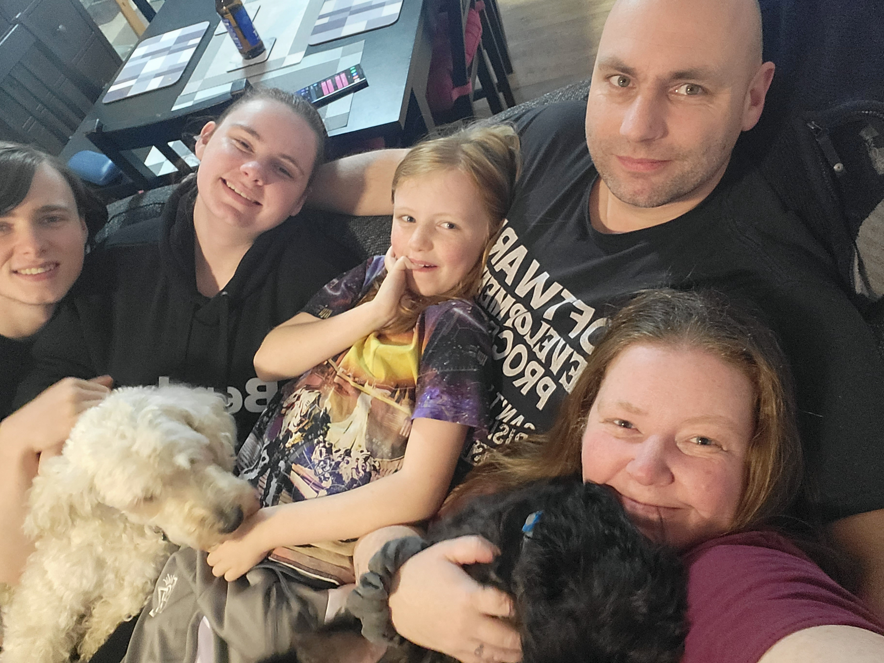
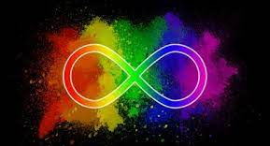
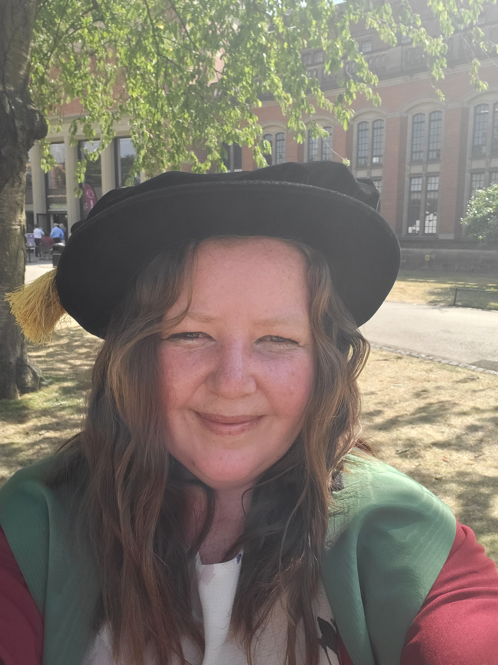
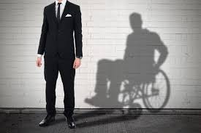
A bit about me
Autism
A
D
H
D
Dyslexia
2

Slide 3
Understanding and supporting the development of an autistic identity and its impact on student wellbeing
Plan of Action
‘Othered’ Identity
Concept
Impact
Masking
Mental Health
Understanding Identity
Concept
Intersectionality
Theory
Autism Specific
Nurturing Identity Development
Peer Support
Belonging
Individuality

Slide 4
What do we mean when we talk about Identity?
“Your identity gives you your sense of self. It is a set of traits that distinguishes you from other people, because while you might have some things in common with others, no one else has the exact same combination of traits as you” (American Psychological Association)
Identity is how we feel in relation to others
Identity requires language – the terms we use are social constructs
Identity as a concept is abstract
Individuals will look ‘outward’ at different points in their life
How can I understand my identity is autistic if I’ve never heard the word autism?!
Which may make it tricker for autistic people to connect with

Slide 5
It is important to remember autism is just ONE identity in many!
ADHD
white
“Autism is just one of my identities, it’s important, but don’t assume it overshadows everything else. See all of me, and then you’ll see what makes me, me!”
autistic
Non binary
Goth
religious
This Photo by Unknown Author is licensed under CC BY-SA

Slide 6
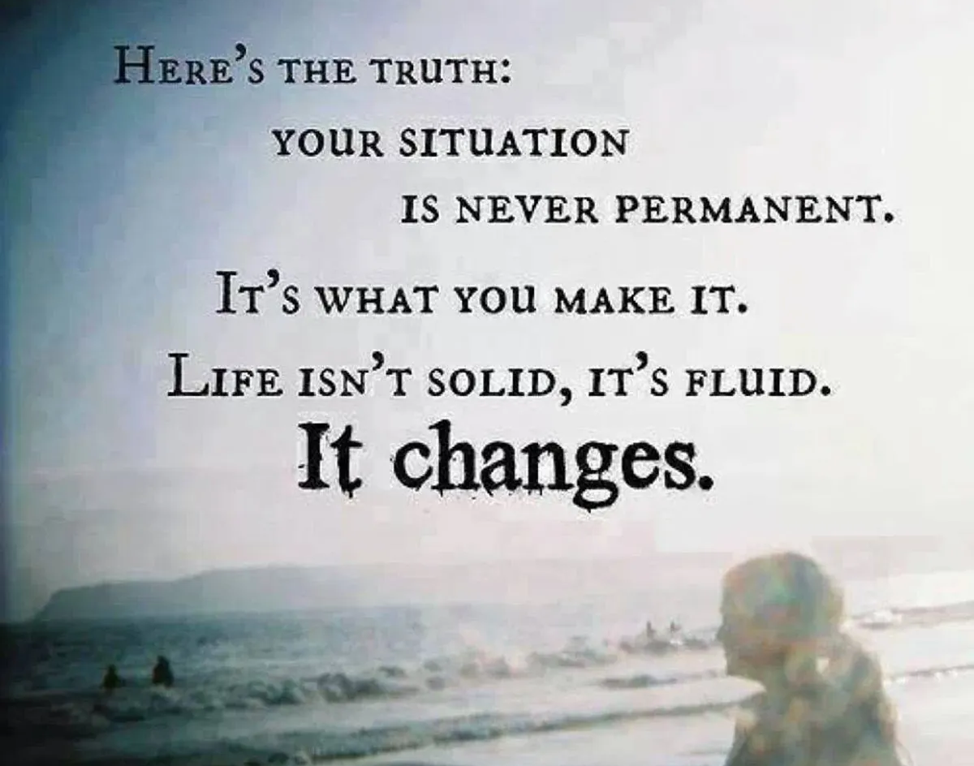
Identities are built “As we encounter our effects on the world and develop our relations with others, these layers build upon each other to produce our identity” (Wenger, 1998, p.151).
But autism is static right?

Slide 7
Identity Development – Marcia’s theory
Identity Diffusion
Identity has not been explored or committed to.
Identity Foreclosure
Low degree of exploration but a high degree of commitment.
Moratorium
High degree of exploration but low degree of commitment
“They are reactive, passively floating through life and dealing with each situation as it arises”
“They are not questioning the values and beliefs they have been taught. Instead, these youth obtain their identity simply by accepting the beliefs and values of those around them.”
“youth are in the midst of an identity "crisis" which has prompted them to explore and experiment with different values, beliefs, and goals.”
Identity Achievement
Both a high degree of exploration and a high degree of commitment.
“strong commitment to a particular set of values, beliefs, and life goals that has emerged from this active exploration and examination”

Slide 8
I wonder what it means to your young people to be autistic (or any other SEND?)
“Do disabled people know who they are because of the fact that they have an impairment, because of the fact that they face discrimination or because of who they, ontologically, believe themselves to be?” (Watson, 2002, p512).
“efforts to define the precise essence of autism escape the best representational practices of scientists and medical practitioners: consequently, even at the dawn of the 21st century, we do not know what autism is.” (Nadesan, 2013, p9)
Were they even involved in the diagnosis? Does it mean anything to them at all?

Slide 9
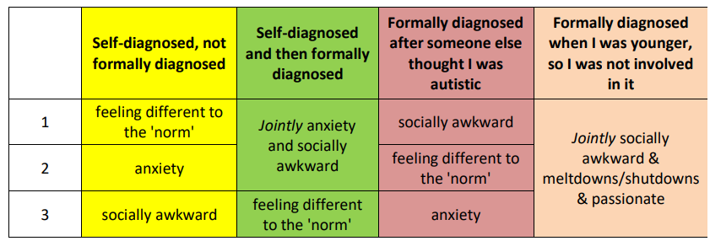
Top 3 identified features of autism were:
Identity foreclosure!
Sandland (2022)

Slide 10
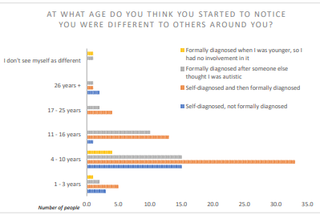
Males 6-11 years
Females 10-12 years
Average age for diagnosis

Slide 11
What is an ‘othered’ identity?
Feeling Marginalised from the ‘in-group’
“It was my sister who provided a vital separation from my feelings of isolation in not being able to make other friends” (Fleisher, 2003, p23).
"I felt like an alien here for my whole life”
“I was gradually becoming more and more aware of my loneliness and began to long for a friend” (Tammet, 2007, p94).
“in sixth grade I was really sad every day….I looked around middle school and I saw that being different was the worst sin of all our peers.” (Kedar, 2012, [blog])
78% of participants reported experiences of bullying. (Sandland, 2022)
Milton and Sims (2016) make reference to an ‘othered’ identity, being on the ‘out-group’ of societal norms. They argue that such experiences are linked to feelings of social isolation, anxiety and depression and would impact on the individual’s ability to develop a secure sense of self/identity.

Slide 12
An ‘othered’ identity – Identity foreclosure
Individual obtains their identity simply by accepting the beliefs and values of those around them.
I had a very strong sense of being in some way "other" and different to other children”
“I just thought I am a very difficult character. I thought I am very stubborn, grumpy, rude, heartless sometimes, not able to love and that it was my fault that I am irritable and never able to enjoy life”
“My counsellor says I’m desperate for acceptance from my family and have been all my life”
“While I figured out how to "accepted" myself in my early twenties, it wasn't until I learned I am autistic that I really began to understand myself.”
“I knew I struggled but didn’t put a name to it”

Slide 13
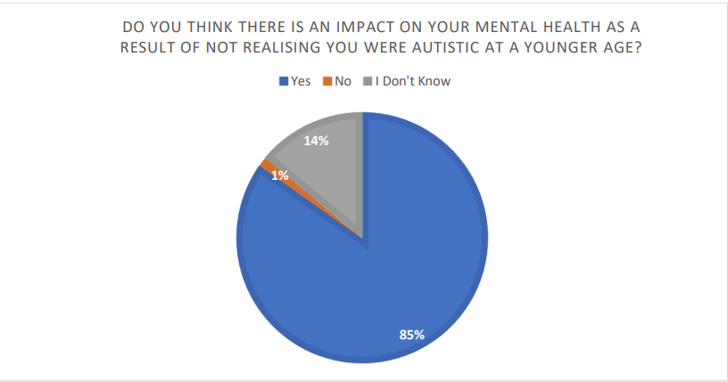
What is the impact of an ‘othered’ identity?
“If children do not feel understood this can affect feelings of intimacy, trust and attachment later in life. “ (Dept for Education)
“Yes, absolutely - from an early age when I was teased about my stims, to preteen age when I struggled socially and experienced a lot of rejection, to misunderstandings as an adult it has had a profound impact”
Over a third of autistic adults have serious mental health problems.

Slide 14
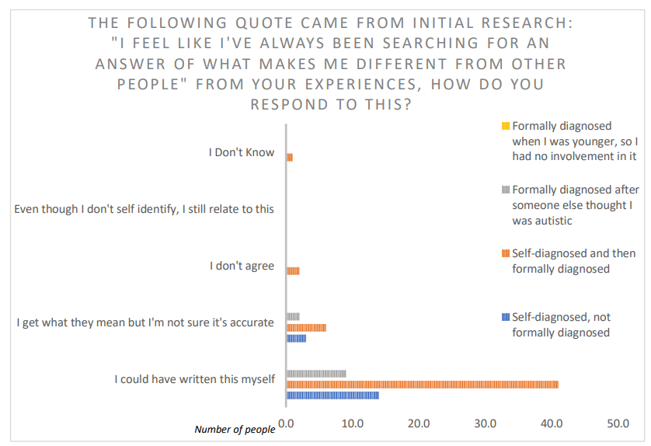

Slide 15
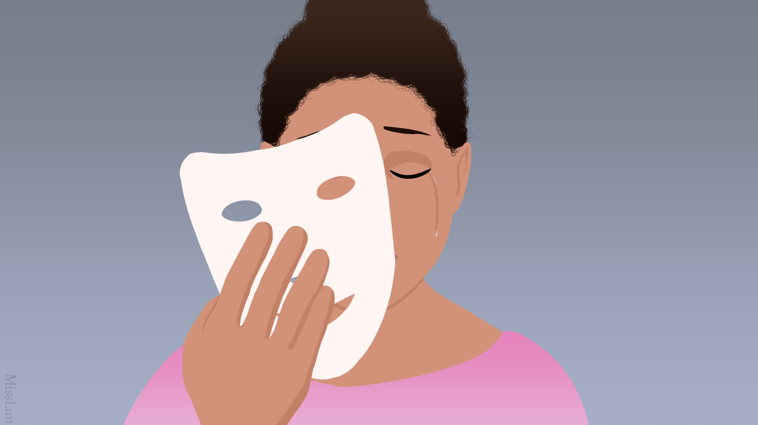
“Yes [it was a conscious decision] I have been masking most of my life.
My first recollection of masking I was about 3 years old.”
“I'm very good at masking, mimicking or pretending to be what people
want me to be”
“I also feel like I've hidden my emotional and social difficulties very
well, so have managed to do things like have interesting jobs and get
onto a PhD course at university, so I might get told I am too successful
to be autistic”
“If I am in prolonged situation where I have to pretend than I will
exhaust my powers sooner.”
“It's a constant struggle for me to maintain a viable sense of self as I spent a long time trying to be whatever people around me wanted me to be (people pleasing is a big issue for me)”

Slide 16
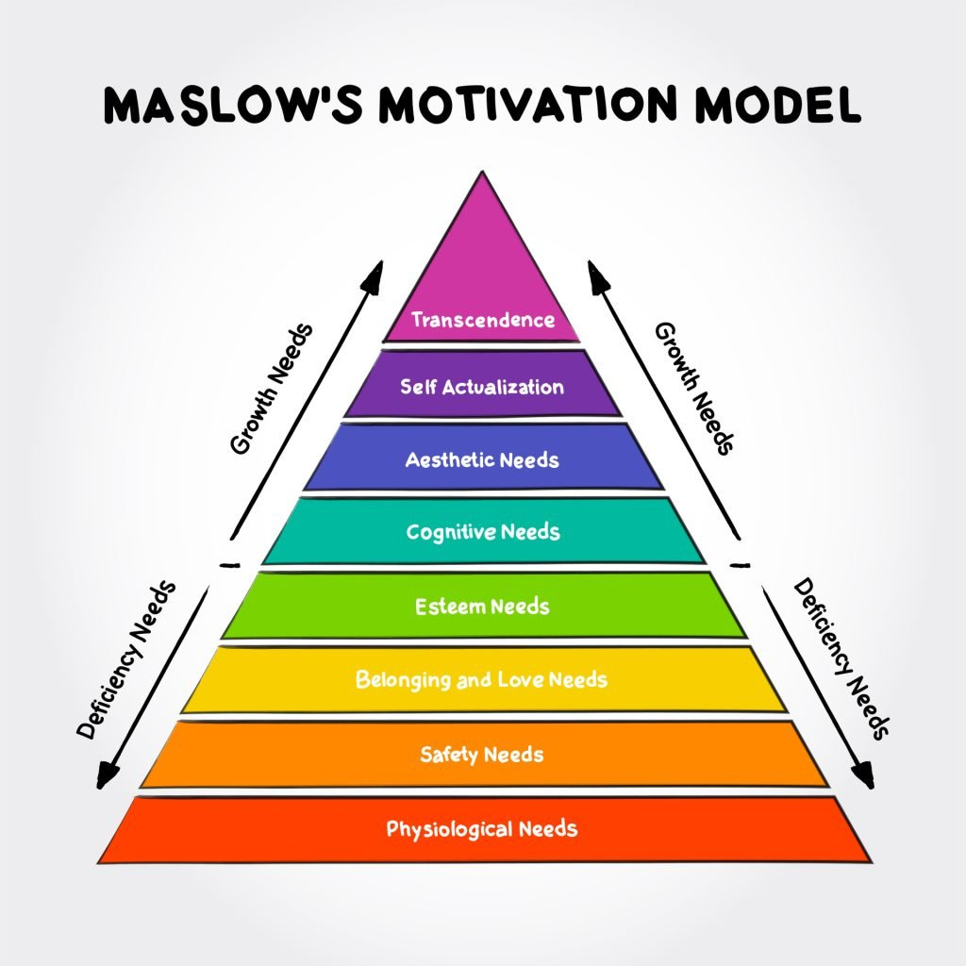
80% of participants in my study (135 people), regardless of gender and diagnosis, reported undertaking masking.
Reasons for Masking
Safety Mechanism due to fear of others
Conscious decision to try to fit in
Consequences of masking
90% ‘emotional exhaustion’,
87% ‘mental exhaustion’
77%. ‘physical exhaustion’
“I work really hard mommy,
so they don’t see I’m struggling”
Camouflaging and unmet support needs appear to be risk markers for suicidality unique to ASC. (Cassidy et al, 2018)

Slide 17
Identity/Authenticity impacts in so many ways
Only 1 in 6 autistic people have a full-time job
Employment / Future Planning
Where do we often start in school career planning
“tell me what you’re interested in”
“what do you think you’re good at?”
“what would you like to spend most of your time doing?”
I have no idea what I’m interested in. Dad does computers, I’ll say that
I don’t really know, I’ll tell you what my teacher says I’m good at.
Being on my own with my dog, but others think that’s weird. I’ll say……. Football

Slide 18
How can we support and nurture the development of an autistic identity?
Moratorium to Achievement

Slide 19
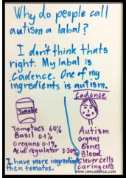
Firstly – recognise autism is an identity and as such the individual needs help to develop it
“But autism is not a terminal disease. It is a trait - or a collection of traits - that a person is born with, and which help define their personality, way of thinking, and - yes - identity.” (Nannery, 2020, {blog}).
“Being autistic, similar to being deaf or blind, is intrinsic to one’s identity and culture, and cannot and should not be separated from people.” (Crosman, 2019, {blog}).
“autism is part of me just as having brown eyes or hair may be part of you” Ackerman (2019, [blog])
Autism DOES define us, because we ARE Autistic. As much as our sexuality defines us, our skin colour, our ailments, our jobs, our traumas, our moments of elation; every aspect of our lives define us. (theautisticadvocate, 2019)
illustrated by a young autistic blogger Cadence (The Autism Label, 2016)

Slide 20
“Take the time to get to know them and find out what things make the classroom environment uncomfortable for them and do your best to accommodate their needs. This may be as simple as ensuring a student is not in the random picker or giving them a seat in a certain part of the room, giving plenty of notice of any changes, etcetera. A few simple changes can make a world of difference to a student with autism, just ask!”
The most powerful tool you have as teachers is yourself!
Above any intervention students report that the biggest impact on their ability to learn is the way the teacher makes them feel!
“If I have one thing to say to teachers, it would be: be involved more with your autistic students and try to find out if anything is going wrong or if they are struggling with something, because most of the time, they will try not to show it.”

Slide 21
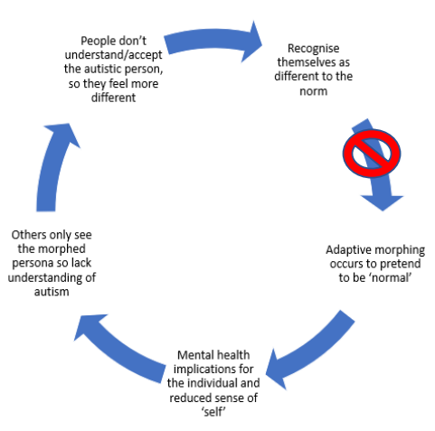
Vicious circle of identification
the vicious circle, as I illustrate here, can only be broken by developing an environment of acceptance that everyone is different from the norm, and that being non-disabled is a temporary state as most people will experience disability at some stage of their lifetime (Shakespeare, 1996).

Slide 22
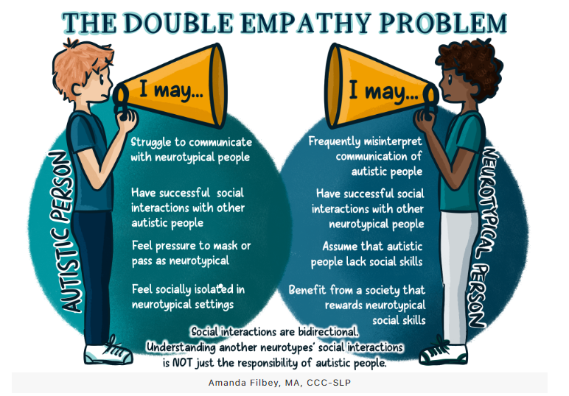
Milton, 2012

Slide 23
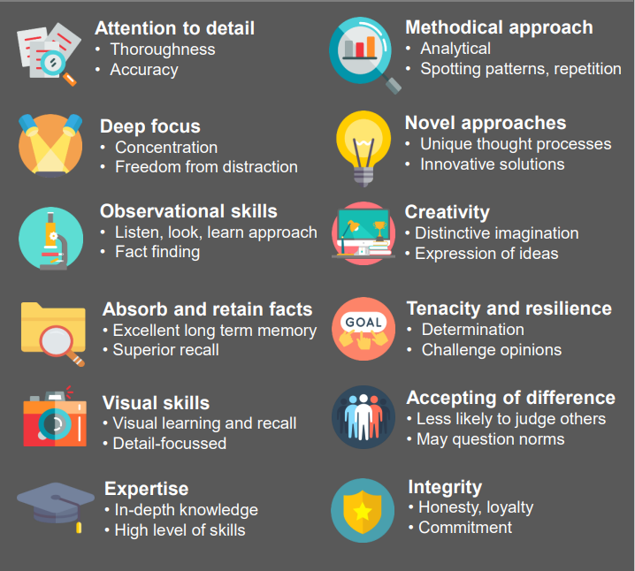
It’s important to recognise the positives of autism

Slide 24
Identity cannot be built in isolation
So far, we have discussion how comparing oneself to a non-autistic person can result in an insecure identity and associated mental health difficulties.
Imagine then what impact it would have when we have the opportunity to meet other autistic people! Too many of our young people think they are alone!
87.7% of participants, or 100 out of 114, expressed that they were, or had been, actively searching for people they could relate to.
“The first book I was reading at work I nearly started crying how close it was describing how I feel”
“It definitely helped with developing my identity. Hearing from so many other people and sharing thoughts and ideas on things like neuro-diversity; really helps with that identity.”
“I found my people. Disabled people. I found my pride. Disabled pride. Autistic pride.” (Sequenzia, n.d. [blog]).

Slide 25
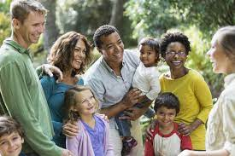
Building Positive Identities

Slide 26
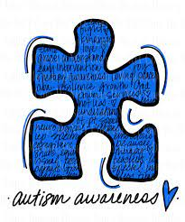
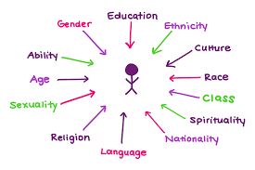
Remember, autism is not the whole!
Wenger (1998) talks of the plurality of identities forming “pieces of a puzzle that go together” (p159). However, the puzzle piece is often used to represent the singularity of autism and the confusion in understanding where it fits within the wider picture.
The puzzle piece stands alone because the autistic identity is made to overshadow all other identities/pieces of the human puzzle. Only by shrinking the autism piece down to mirror the sizes of the other pieces of the human puzzle can we enable the autistic puzzle piece to effectively aid the construction of the individual’s nexus of identities.
Don’t use, autistic community hates it!

Slide 27
If learning is not just about “learning to do” but also, importantly, about ‘learning to be’ then those who have a role in supporting learning need to pay explicit attention to supporting identity work”
(Wenger-Trayner and Wenger-Trayner, 2015)

Slide 28
My Takeaways
Autism is an identity not just a diagnosis
Autism isn’t static
Autism is just one of many identities, don’t let it overshadow the others
Children and Young people need to learn about autism and be supported in understanding what it means to them
We need to make sure we balance the negative undertones of the SEND system with positives
Children work out they are ‘different’ really young
Autistic children often fear the way other people (peers and teachers) will react to them
Masking can start as early as 3 years old! And is not gender specific
Masking is physically and emotionally exhausting
An insecure identity impacts the child’s ability to learn and has lifelong implications
Getting autistic people together is vitally important
How can you make sure your autistic children are ‘seen’?

Slide 29
References
Ackerman, M., (2019). Why Autism doesn't end at 18. [Blog] Edge of the Playground. Available at: https://edgeoftheplayground.com/2019/01/23/why-autism-doesnt-end-at-18/Crosman, 2019
American Psychological Association (n.d.) - Identity. https://dictionary.apa.org/identity
Cassidy, S.A., Robertson, A., Townsend, E. O’Connor, R.C. and Rodgers, J., (2020) Advancing Our Understanding of Self-harm, Suicidal Thoughts and Behaviours in Autism. J Autism Dev Disord 50, 3445–3449. https://doi.org/10.1007/s10803-020-04643-9
Dept for Education: https://help-for-early-years-providers.education.gov.uk/personal-social-and-emotional-development/sense-of-self
Fleisher, M., (2003). Making sense of the unfeasible: My life Journey with Asperger’s. London: Jessica Kingsley.Tammet, 2007
Kedar, I., (2012). March. Letter to a Friend with Autism. [Blog] Ido in Autismland. Available at: http://idoinautismland.com
Milton, D. (2012). On the ontological status of autism: the 'double empathy problem'. Disability & Society, 27 (6). pp. 883-887
Milton, D. and Sims, T., (2016). "How is a sense of well-being and belonging constructed in the accounts of autistic adults?" Disability & Society. 31:4. 520-534
Nannery, S., (2020). What’s with “Identity First” or “Person First” Language?. [Blog] Sarah Nannery, Available at: https://www.sarahnannery.com/post/what-is-with-identity-first-or-person-first-language
Sandland. B (2022). The spiral of self-identification of autism. Understanding self-identification of autism through firsthand experiences. Available at: https://etheses.bham.ac.uk/id/eprint/12143/
Sequenzia, A., (n.d.). Being Proudly Autistic. [Blog] Ollibean. Available at: https://ollibean.com/proudly-autistic/
Shakespeare, T., (1996). Disability, Identity and Difference. In: C. Barnes and G. Mercer, ed., Exploring the Divide. Leeds: The Disability Press, 94-113.
The Autism Label., (2016). [Blog] iamcadence. Available at: https://iamcadence.com/2016/07/10/the-autism-label/theautisticadvocate, 2019
Watson, N., (2002). Well, I know this is going to sound very strange to you, but I don’t see myself as a disabled person; identity and disability. Disability & Society. 17:5. 509-527.Nadesan, 2013
Wenger, E., (1998). Communities of Practice; Learning, meaning and Identity. Cambridge; Cambridge University PressMaria’s theory - https://www.mentalhelp.net/james-marcia/
Wenger-Trayner, E. & Wenger-Trayner, B. (2015) Learning in a landscape of practice: A framework, in E. Wenger-Trayner, M. Fenton-O'Creevy, S. Hutchinson, C. Kubiak, & B. Wenger-Trayner (eds.), Learning in landscapes of Practice, Oxon: Routledge, pp. 13-29.

Slide 30
Thank You
Dr Barbara Sandland
b.sandland@bham.ac.uk
@barberela
dr-b-sandland

